Slide 1
AMA - 25th July
Microsoft Clarity By Pankaj Singh
clarity.microsoft.com

Slide 2
Our Agenda - Microsoft Clarity
Clarity is a cutting-edge behavioral analysis tool that helps you understand user interaction with your website.
01
Problems with Sessions Recoding tool:
We will discuss the issues that limit our ability to use any such tool. And make us not to use it at all.
04
Why should we use Clarity?
A few scenarios where Clarity can be best-used
02
Solution/s:
Effective ways to use session recording tool with it’s full potential. And use the data to get all your question answered.
05
Implementation:
We will discuss its implementation. I will show you ‘how to implement it on screenshare.’
03
Definition & Supported Features:
Sessions Recording
Heatmaps (or heat maps)
ML Insights
06
Example ‘Use Cases:’
We will discuss a few real-life examples to understand the Microsoft Clarity better.

Slide 3
Problems With Session Recoding tool
Data Pile
A
Data Filtering
B
It is impossible to watch thousands of sessions recordings.
Biggest problem is lack of segmentation in such tools.
No or very less ability to customize the data recordings.
Not providing much useful information except recordings.
Restrictions
D
Limited Info
E

Slide 4
Solution
Data is secure, Clarity is GDPR-compliant.
Session Recordings
Heatmaps (or heat maps)
ML Insights
Ability to add custom filters and segment data.
Secure
Data
User
behavior
Dead clicks, Rage clicks, Excessive scrolling, and Quick backs.
ML Algorithms
Customize
Solution
Microsoft Clarity

Slide 5
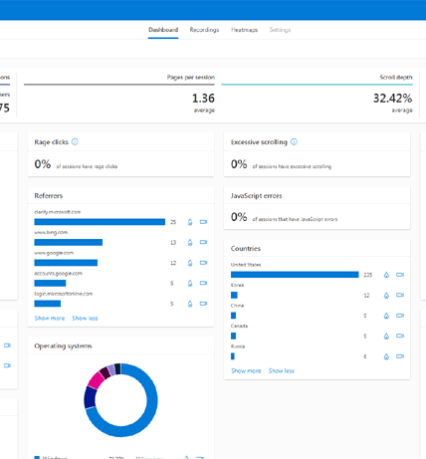
Definition & feature
Clarity is a cutting-edge behavioral analysis tool that helps you understand user interaction with your website.
By using Clarity's robust analysis tools, you can enhance your website for your clients and your business.
Sessions Recording
It records Scrolling, Tapping, Clicking, Mouse movements, Swiping, and Typing.
Heatmaps
We can see click and scroll heatmap within Microsoft Clarity.
ML Insights
Microsoft Clarity tracks Dead clicks, Rage clicks, Excessive scrolling, and Quick backs.

Slide 6
Why Microsoft Clarity?
Simple and easy customization makes Clarity best for your business.
Clarity won't get in the way of your site's performance.
No sampling. Clarity process more than 1 petabyte of data from over 100 million users per month.
Also, there are no traffic limits on these sites.
Data is analyzed and ready to view in near real time, so you don't have to wait.
Deep AI and Machine Learning algorithms power insights to help you analyze user behavior efficiently.
There are absolutely no limits on the number of sites per account.
Clarity can scale to support even the largest websites.
01
02
03
04
+
+
+
+

Slide 7
Implementation Process
Signup to Microsoft Clarity.
Add your website as a Project.
Add script through GTM. Also link GA property.
Implement custom tags for segmentation.
We are done, wait to record the data.

Slide 8
Example: Use Cases
Troubleshooting
In Case of any issue on the website, we can quickly jump on session recordings data and watch for specific user actions using these event/tag filters.
Get Your Questions Answered
According to our need we can filter out the exact and limited number of recordings. It will make it easy to watch and get out question answered quickly.
Finalizing the audience for retargeting ads
We can use segments such as sessions with begin checkout but purchase. And then analyze what was the biggest reason to drop-off. If there is any visible issue then fix the same and retarget to the visitors to come back and place the order again with personalized message.

Slide 9
Thank you ☺

